Slide 1
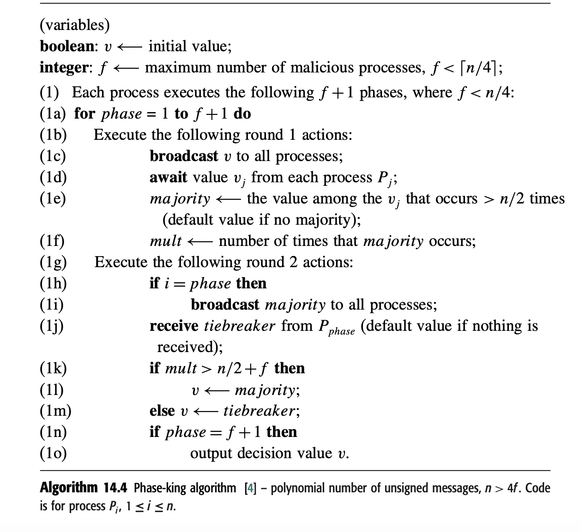
Phase King Algorithm
If neither 0 or 1’s are greater than n/2, which may happen when the malicious processes do not respond, and the correct processes are split among themselves, then a default value is used for the majority variable.
Pi
its
If correct processes have equal 0 and 1’s then no correct process can have mult >n/2+f. Because for this to happen all f faulty ppl should send say 0. and apart from them you also need grt than n/2 ppl sending 0. bus only half of non faulty ppl have 0 which is less than n/2. so everyone will use tie breaker so all will decide the same value
Notes:
If majority is set to default then is mult still number of times that default occurs?

Slide 2
Proof
There are f+1 phases but only f malicious process hence at least one of the phase kings is non malicious. Let that be for phase K. Consider the three cases that might be true for two non malicious process Pi and Pj. 1. Pi and Pj decided on their majority value at the end of round K
2. Pi and Pj decided on the phase king value at the end of round K
3. Pi decided on majority and Pj decided on phase king value at the end of round K

Slide 3
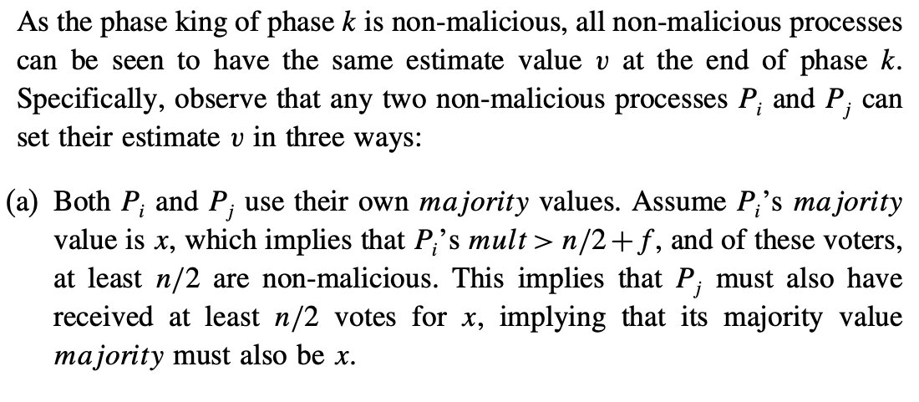
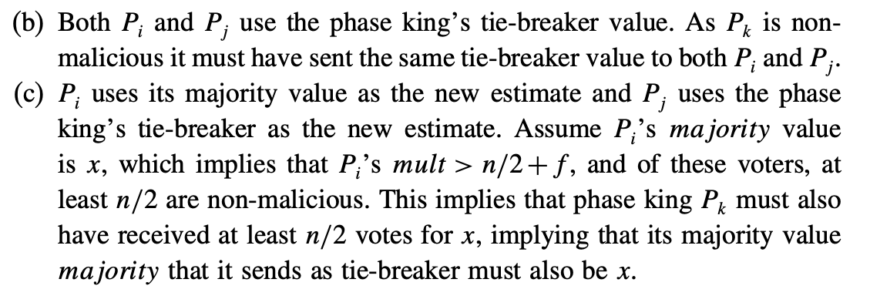
Proof
Notes:
What if phase king did not get n/2+f due to which it sent default value ---not possible as non malicious phase king always sends majority even if less than n/2+f

Slide 4
Proof
Once a non malicious phaseking executes his two rounds; the values of the non malicious processes will not change with any further phase king rounds Going forward, all the non faulty processes already have agreed on a same value. That is more than 3n/4 process now have the same value of v which they send everyone else in round1 of future phases. So all non faulty ppl will get a clear majority of > n/2+f and will continue to decide on their v value.

